Slide 1

GO TEAM Meeting #3: December 20, 2024

Slide 2
Every Child, Every Chance, Every Day!
PBSA and Price Vision and Mission
PBSA Cluster Vision and Mission
Vision : We graduate empowered change agents who create positive, long-lasting impact in their communities.
Mission: We cultivate students’ skills and agency in pursuit of their unlimited potential.
Price Middle School
Vision : Luther J. Price Middle School exists to improve our community by empowering and equipping our students with the skills needed to graduate and live liberated choice-filled lives.
Mission: Students at Price Middle School are empowered through academic acquisition, leadership development, authentic problem solving, and student-centered ownership leading to them reaching their unlimited potential.

Slide 3
Recent Events in the Wildcat Den

Slide 4


What’s Happening at Price?
Please check the website for weekly updates

Slide 5
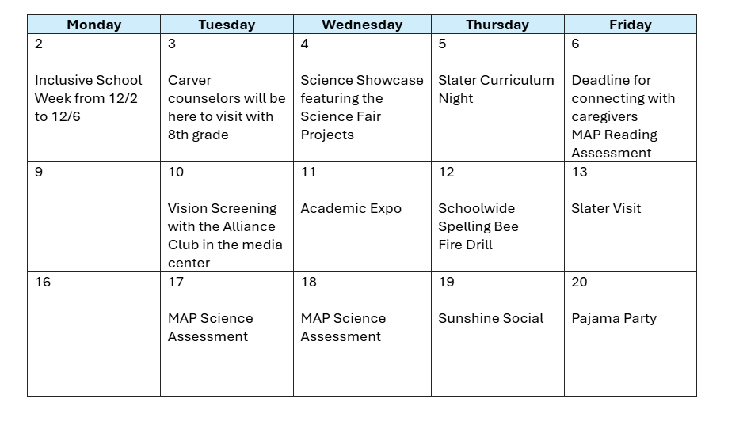

December Events

Slide 6
PBSA R3 Data Process/2nd Semester Focus

Slide 7

Goal #1
R3 Process Review, Reflect, Refine
Goal / Expected Outcome #1:
By May 2025, 75% of students will meet the CCRPI standard for attendance
Timebound, Chunked Goal (Q2):
By December 20, 2024 65% of students will meet the CCRPI standard for attendance.
School Action Step:
As a school, 100% of students are accounted for daily.
*All previous action Steps will continue. Highlighted action steps have been added for Q2

Slide 8

Goal #2
R3 Process Review, Reflect, Refine
Goal / Expected Outcome #2:
By May 2025 students scoring developing and above in ELA will increase from 53% to 60%. By May 2025 students scoring proficient and above in ELA will increase from 15% to 17%.
By May 2025, teachers will be able to integrate at least two writing strategies into the curriculum in all content areas, and students will proficiently respond using a constructed response based on the writing rubric.
Timebound, Chunked Goal (Q1):
By December 20, 2024 teachers will show evidence of student writing through daily observable instruction.
School Action Step:
100% of teachers will incorporate weekly constructed response in all content areas
*All previous action Steps will continue. Highlighted action steps have been added for Q2

Slide 9
Fall to Winter Map Overview

Slide 10
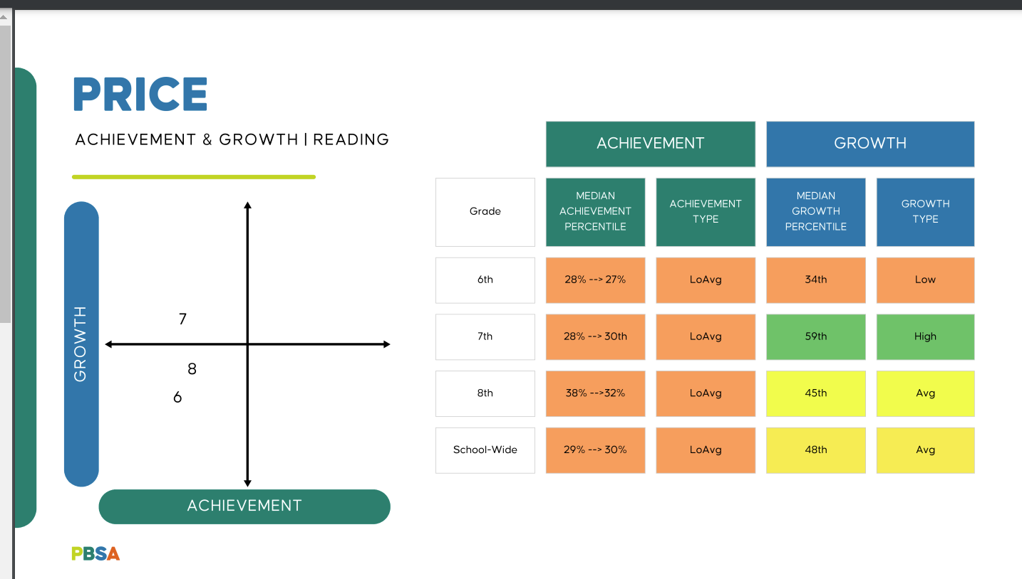
Fall To Winter Reading

Slide 11
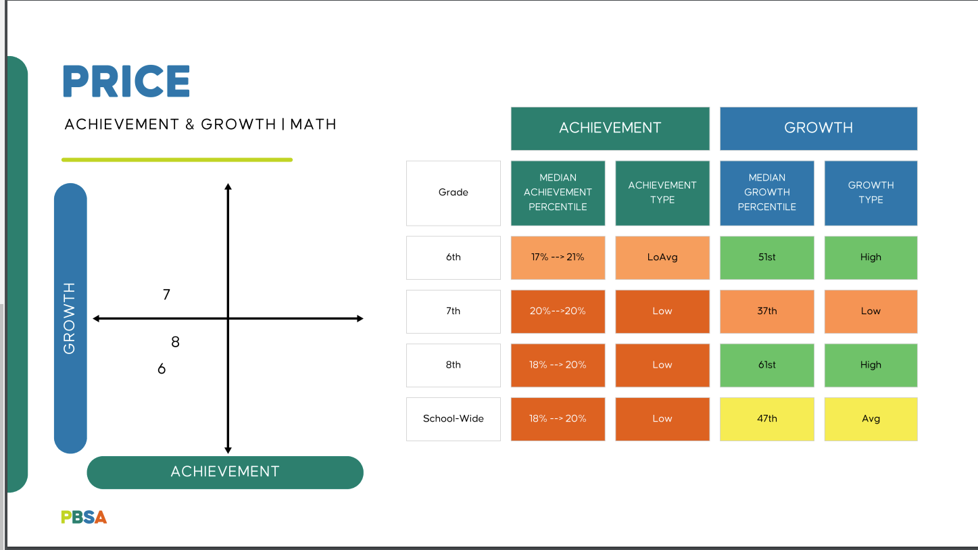
Fall To Winter Math

Slide 12
